Slide 1
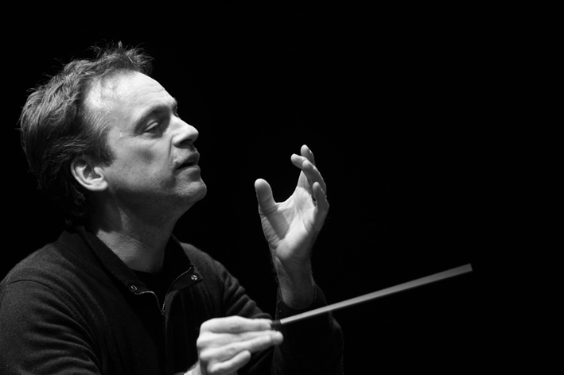
Jonathan Nott
Conductor
October 2013

Slide 2
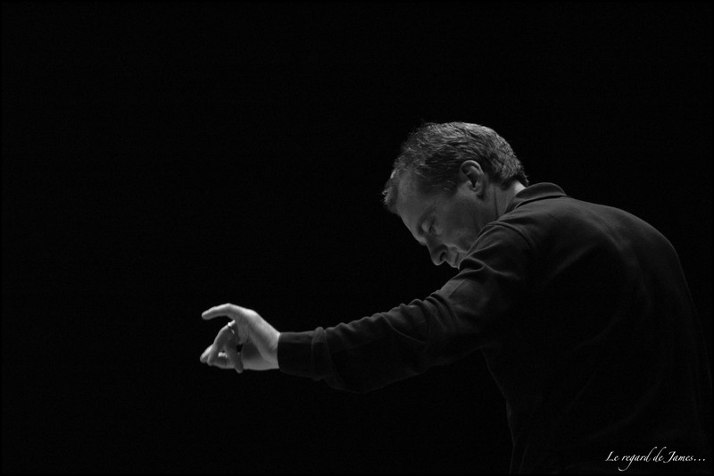
Jonathan Nott (born 25 December 1962,
Solihull, England) is an English conductor, the son of a priest at Worcester Cathedral.
He was a music student and choral scholar at the University of Cambridge, and also studied singing and flute in Manchester at the Royal
Northern College of Music.

Slide 3
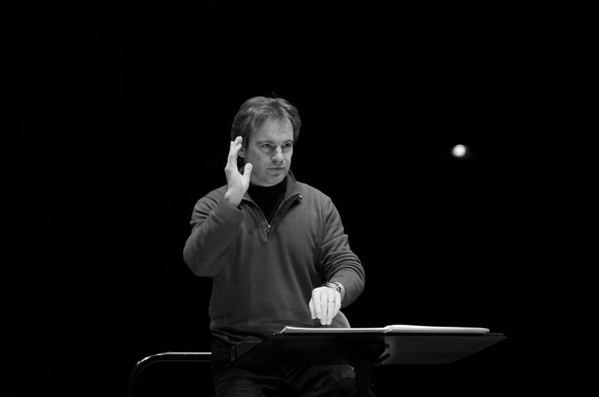
Nott made his conducting debut in 1988 at the Opera Festival in Battignano, Italy. In 1989, he was appointed Kapellmeister at the Frankfurt Opera. In 1991, he was appoin- ted Erster Kapellmeister at the Hessisches Staatstheater Wiesbaden, and became interim chief conductor for the 1995–96 season.

Slide 4
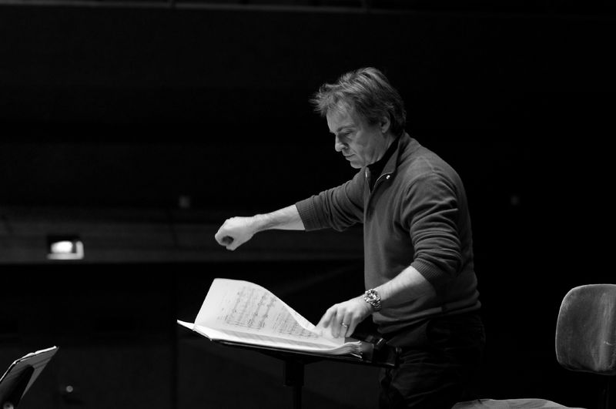
Nott became principal conductor of the Bamberg Symphony Orchestra in January 2000. With the orchestra, he made his New
York City conducting debut.
Several years after his 2009 contract extension through the
2011-2012 season, in 2011, Nott and the orchestra agreed on a further extension of his contract with the
Bamberg Sympho ny through the
2015-2016 season.

Slide 5
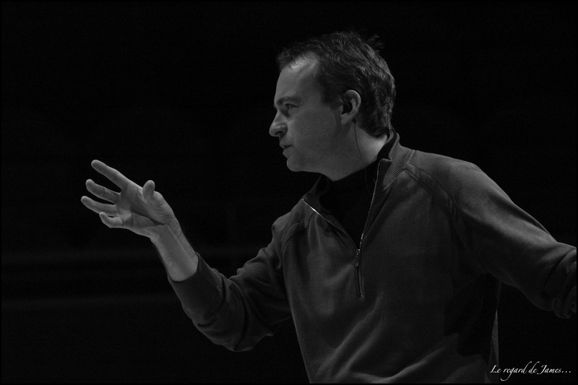
Nott first guest-conducted the Tokyo Symphony Orchestra in October 2011. Immediately following this engagement, the orchestra offered him its music directorship, which he accepted immediately. The orchestra for- mally announced Nott's appoint- ment as its next music director in October 2012, effective with the 2014-2015 season, for an initial contract of 3 years, conducting
8 weeks of concerts per season.

Slide 6
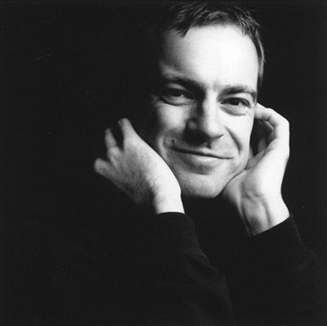
Viktoria Kosogova
Grade 11

