Slide 1
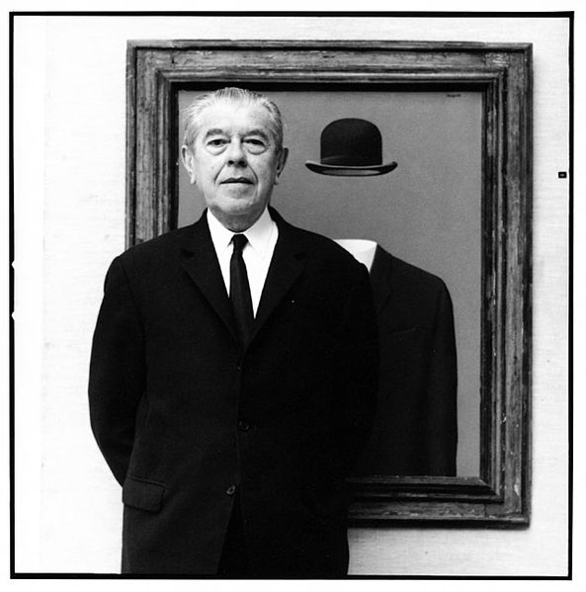
2011
René Magritte
St. Petersburg

Slide 2
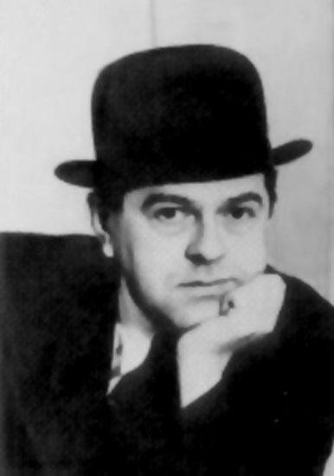
René François Ghislain Magritte
(21 November 1898–
15 August 1967) was a Belgian surrealist artist. He became well known for a number of witty and thought-provoking images. His work challenges observers' preconditioned perceptions of reality.

Slide 3
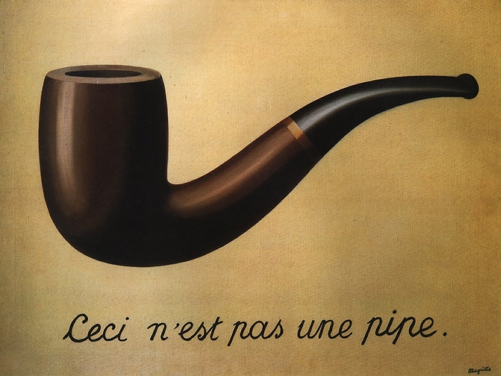
Magritte's work frequently displays a collection of ordinary objects in an unusual context, giving new meanings to familiar things. The use of objects is other than what they seem is typified in his painting, The “Treachery of Images”, which shows a pipe that looks as though it is a model for a tobacco store advertisement. Magritte painted below the pipe "Ceci n'est pas une pipe" ("This is not a pipe"), which seems a contradiction, but is actually true: the painting is not a pipe, it is an image of a pipe.

Slide 4
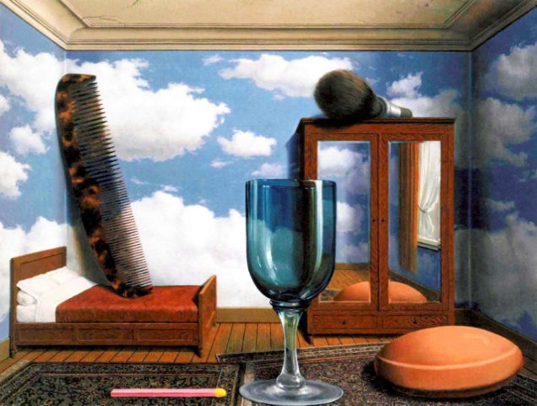
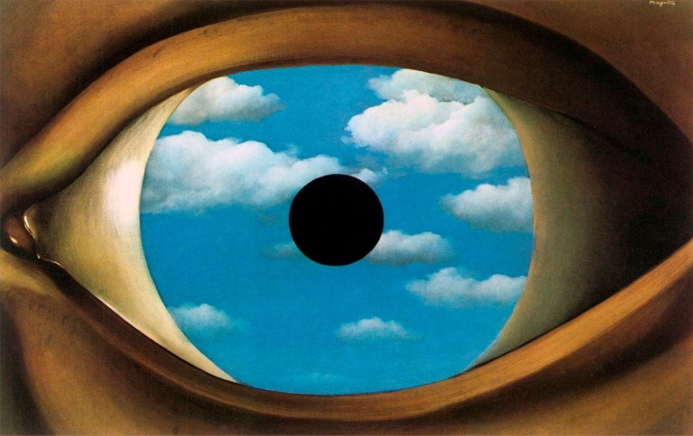
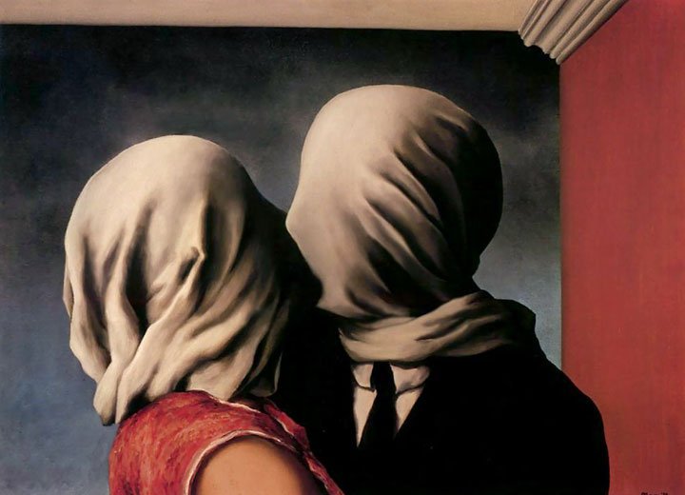
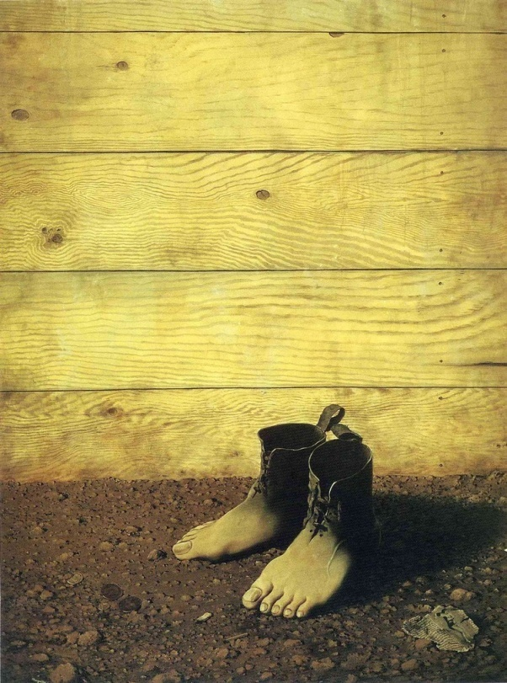
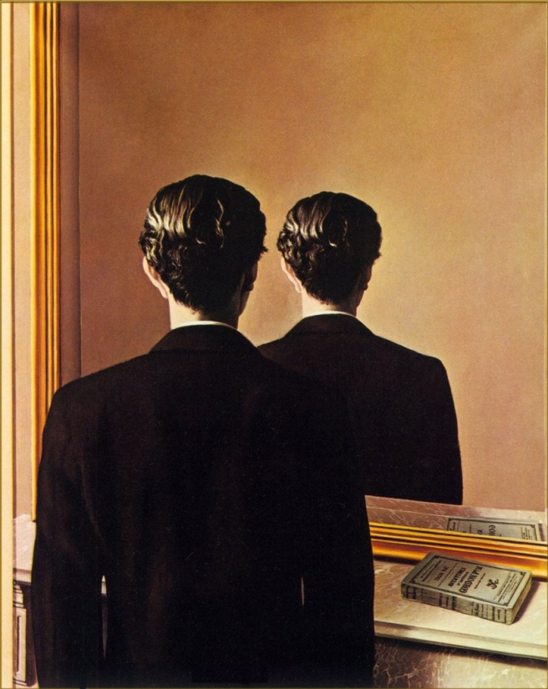
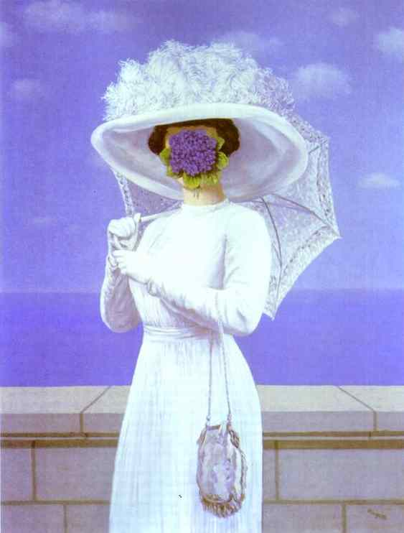
Personal Values
The False Mirror
The Lovers
The Red Model
Not to be Reproduced
The Great War

Slide 5
The son of man
“The Son of Man” was painted in 1964 by the Belgian surrealist painter René Magritte. Magritte painted it as a self-portrait. This picture was painted in oils on canvas.

Slide 6
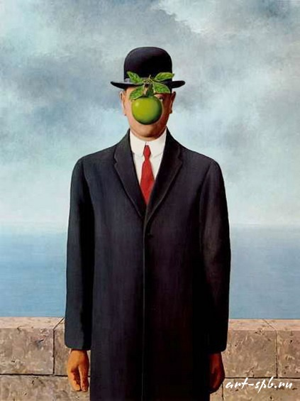
The son of man
In the background there is a short wall, sea and cloudy sky.
In the centre of the painting we can see a man in an overcoat and a bowler hat.
The man's face is largely obscured by a hovering green apple.

Slide 7
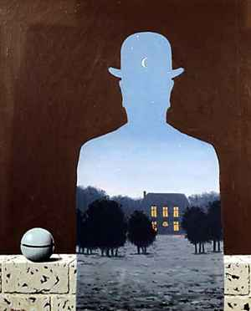
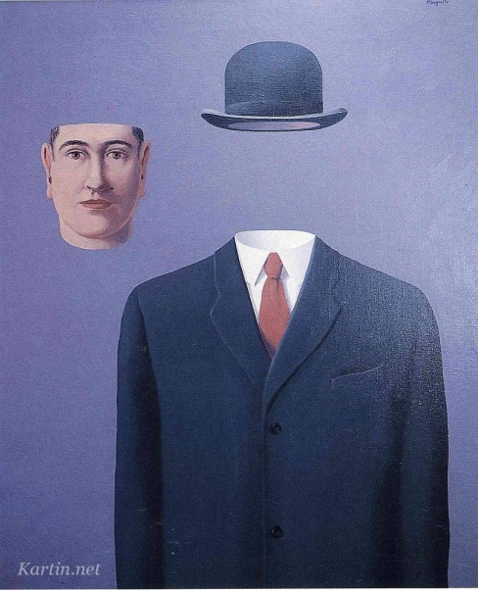
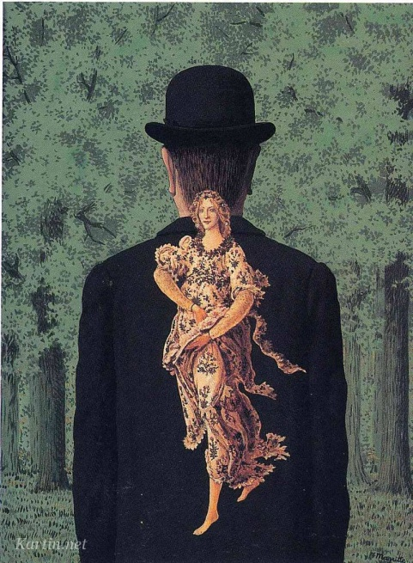
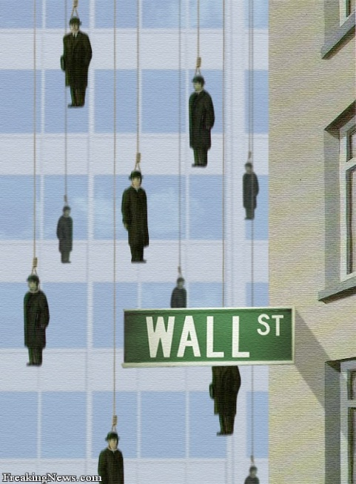
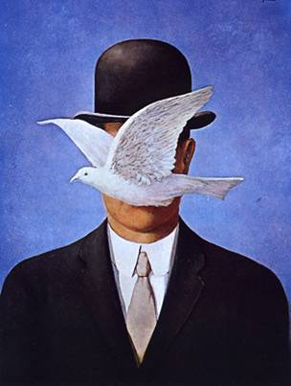
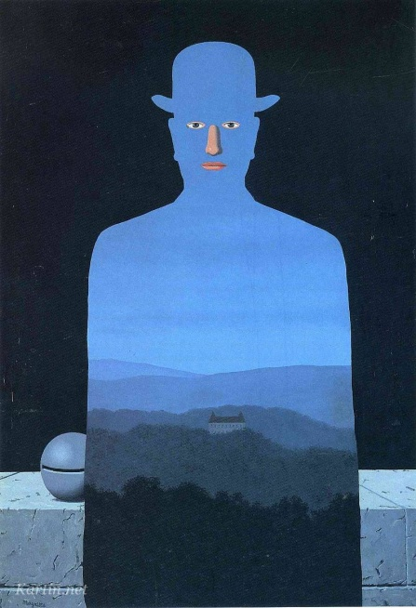
“The Son Of Man” is not only a picture in which we can see himself. At many of his paintings Magritt shows himself or his silhouette.

Slide 8
Iukkanen daRia
Presentation made by
Grade 10

