Slide 1
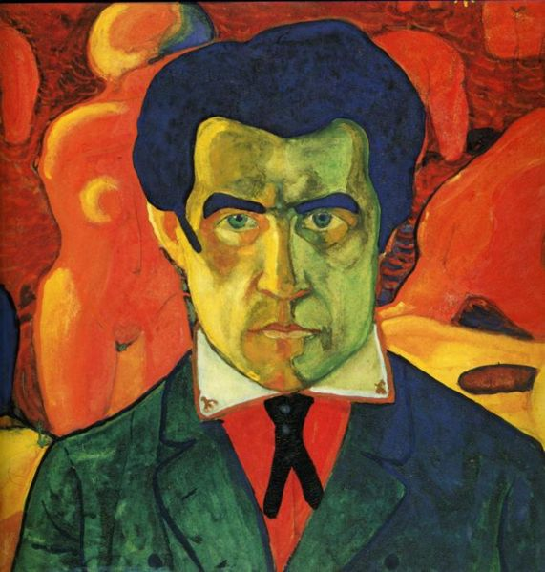
Kazimir Malevich
St. Petersburg 2011

Slide 2
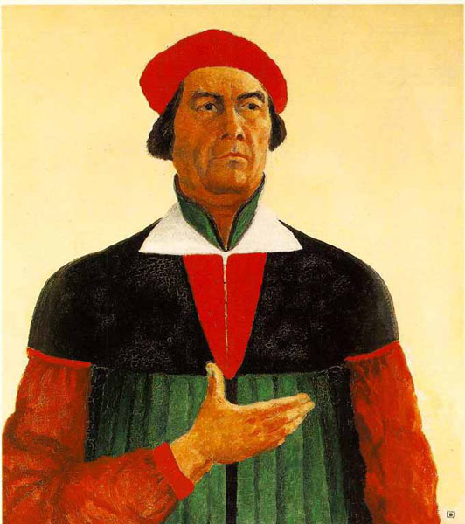
Self-Portrait
Kazimir Severinovich Malevich was born
23 February 1879 in Kiev.
The avant-garde artist was born into a family of a factory manager.
In 1895-1896 he studied at the art school…

Slide 3
Malevich`s works in museums
Malevich’s paintings are in many museums of various countries and cities such as : Astrakhan , London , New York , Paris , Yekaterinburg , Saratov , Moscow ,
St. Petersburg , and so on .

Slide 4
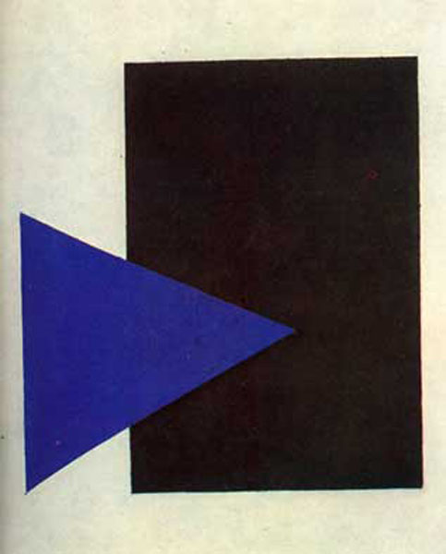
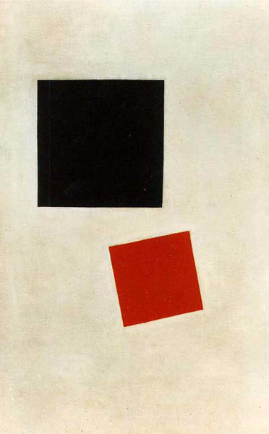
Malevich loved to draw shapes
“The Blue triangle and black rectangle”
“The Black and
red squares”

Slide 5
The most famous figure is Malevich’ s “Black Square”

Slide 6
“The Black Square” was created in 1915 .
Malevich drew a picture for a few months (summer and fall) .
The painting was exhibited at an exhibition
in Saint-Petersburg in December , 1915 .
Malevich painted more than 4 black
squares and circles.

Slide 7
“The Black Circle”

Slide 8
Kazimir Severinovich Malevich died on 15 May 1935 in Leningrad .

Slide 9
The presentation made by Eva Tykke 10 grade

