Slide 1
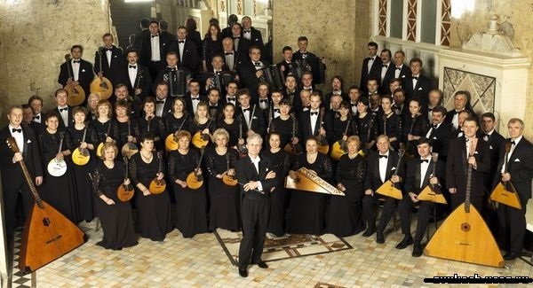
The composition of Russian Folk Orchestra
S. Petersburg, October 2013

Slide 2
Russian folk orchestra includes 6 main groups of instruments
1.
Domras.
Domra – a Russian folk stringed musical instrument with three or four strings. Used to produce sound pick.

Slide 3
Domra
Luckin Karmen.Domra.
A.Tsygankov. “March Dando”

Slide 4
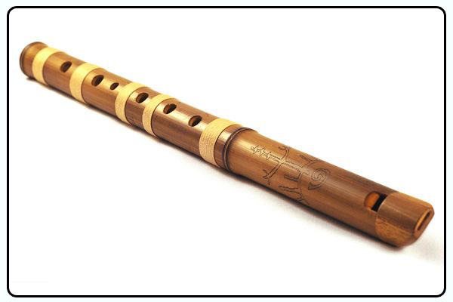
Russian folk orchestra includes 6 main groups of instruments
:
2.
Winds
One of them – The Pipe
The Pipe – an ancient wind instrument,a sort of longitudinal flutes.

Slide 5
2. The Pipe
NAONIR them. Osipov, conductor Nikolai Kalinin, S. Butushin soloist (flute)
Ennio Morricone -
lonely shepherd.
(it is not Russian folk pipe, but still beautiful)

Slide 6
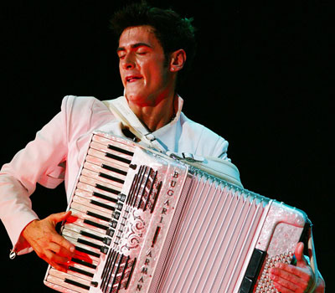
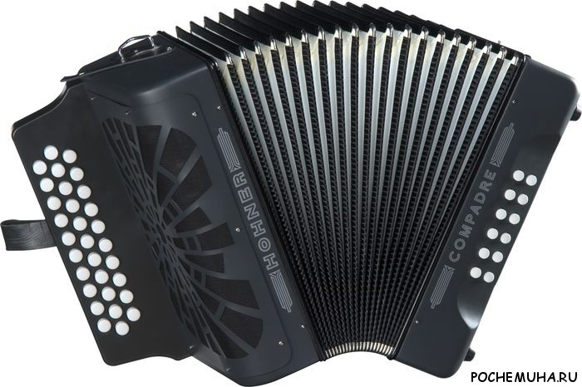
Russian folk orchestra includes 6 main groups of instruments
:
3.
Orchestral Harmonicas
(Accordions)
Accordion - reed keyboard-pneumatic instrument.

Slide 7
3. Accordion (Harmonic)
A.Vivaldi – Seasons(winter).
G. Sviridov - the snowstorm

Slide 8
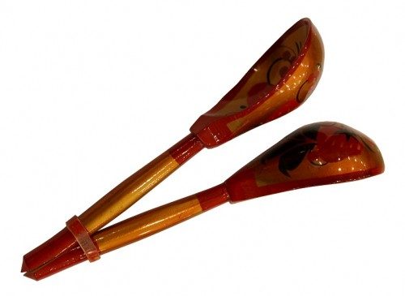
Russian folk orchestra includes 6 main groups of instruments
:
4.
Percussion musical instruments.
One of them are spoons and I’ll tell you about it.
Wooden spoons are used in the Slavic tradition as a musical instrument. Slot 3 is set to 5 trays, sometimes different sizes.

Slide 9
4. Spoons
Igor Rasteryaev plays.
Russian Folk Orchestra Pyatnitsky Choir - Russian Polka

Slide 10
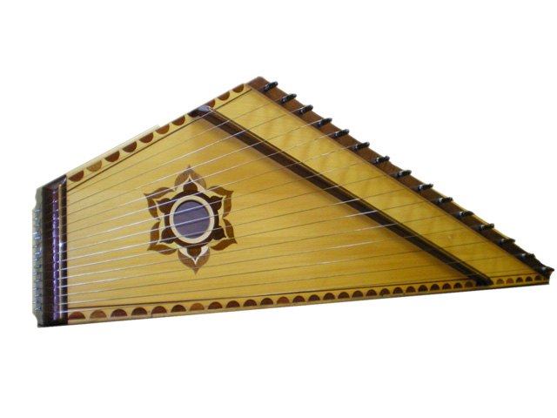
Russian folk orchestra includes 6 main groups of instruments
:
5.
Gusli
Gusli - a stringed musical instrument that is common in Russia. It is the most ancient Russian stringed musical instrument.

Slide 11
5. Gusli

Slide 12
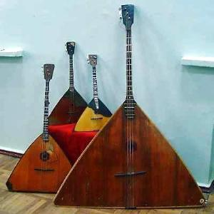
Russian folk orchestra includes 6 main groups of instruments
:
6.
Balalaika
Balalaika - Russian national three-stringed plucked musical instrument

Slide 13
6. Balalaika

Slide 14
Churkin Vladimir Grade 11a Thanks for watching!

